Slide 1

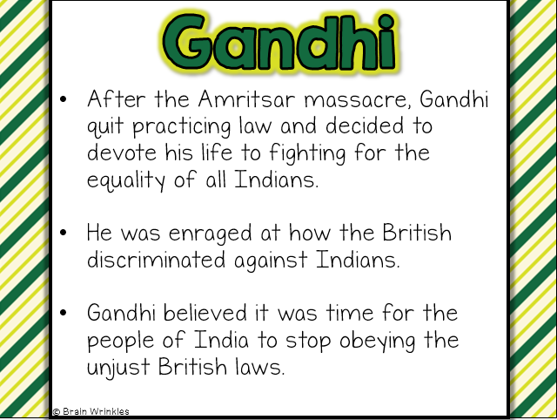
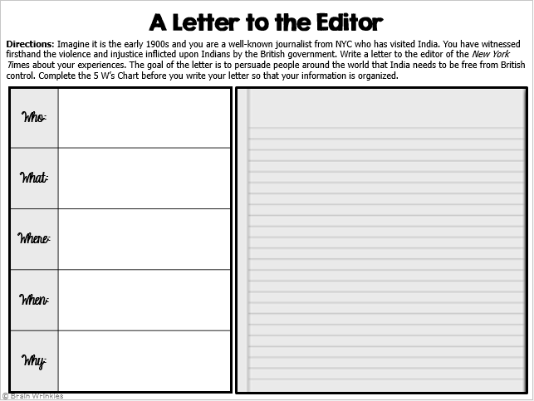
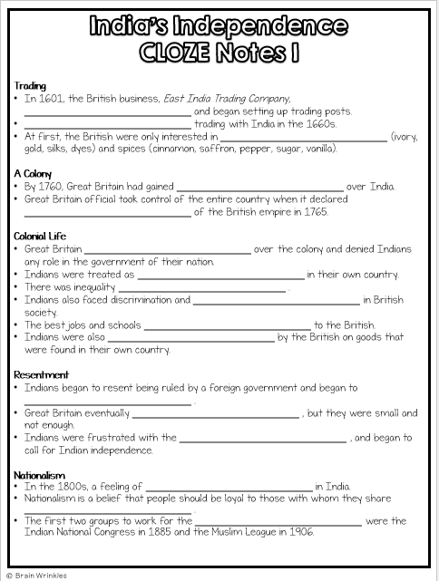

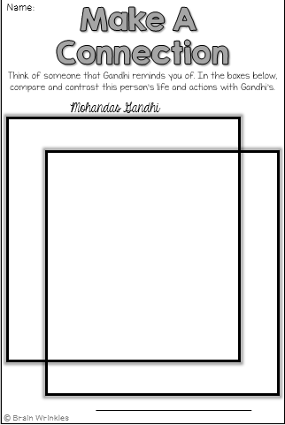
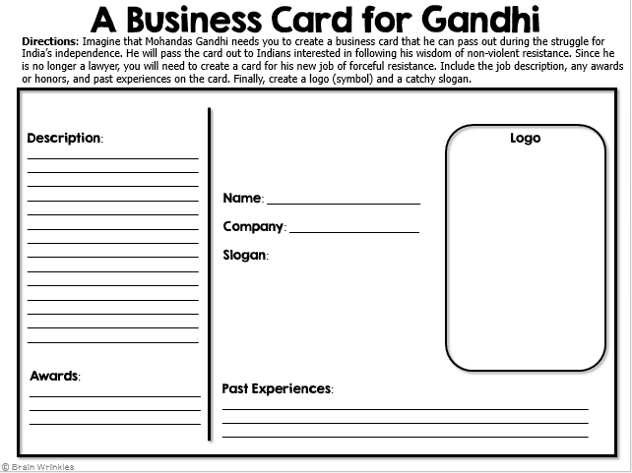
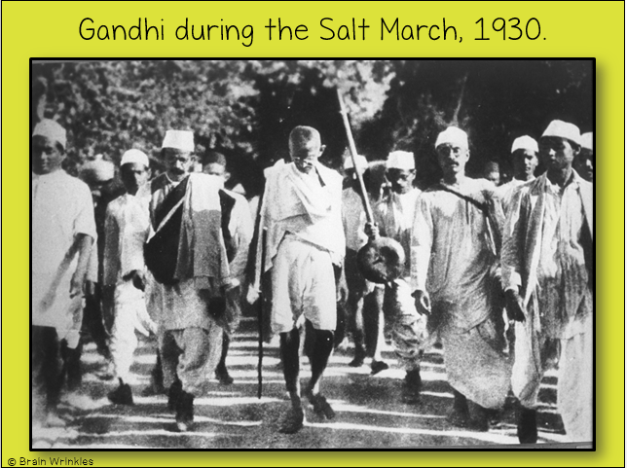
India’s
INDEPENDENCE
INDEPENDENCE
Nationalism & Gandhi
Presentation, Graphic Organizers, & Activities

Slide 2
STANDARDS:
SS7H3 Analyze continuity and change in Southern and Eastern Asia.
Describe how nationalism led to independence in India.
Describe the impact of Mohandas Gandhi’s belief in non-violent protest.
© Brain Wrinkles

Slide 3

India’s
Independence
© Brain Wrinkles

Slide 4
Trading
In 1601, the British business, East India Trading Company, arrived in India and began setting up trading posts.
Great Britain began trading with India in the 1660s.
  At first, the British were only interested in trading goods (ivory, gold, silks, dyes) and spices (cinnamon, saffron, pepper, sugar, vanilla).
© Brain Wrinkles

Slide 5
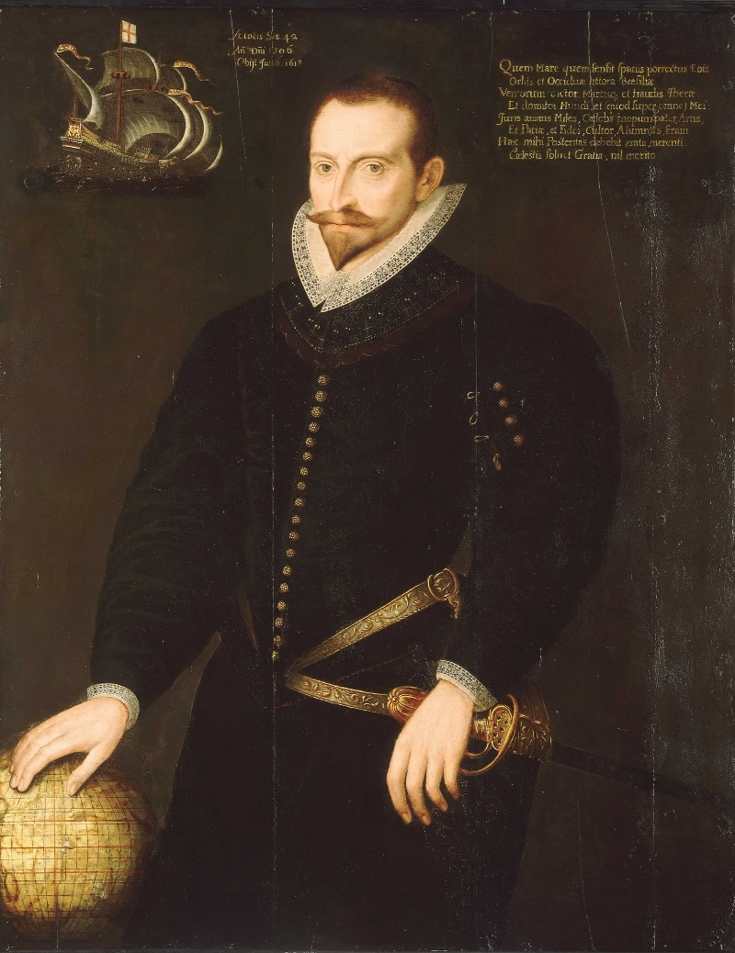
Sir James Lancaster commanded the first East India voyage in 1601.
© Brain Wrinkles

Slide 6
A Colony
By 1760, Great Britain had gained economic and political control over India.
Great Britain official took control of the entire country when it declared India a colony of the British empire in 1765.
© Brain Wrinkles

Slide 7
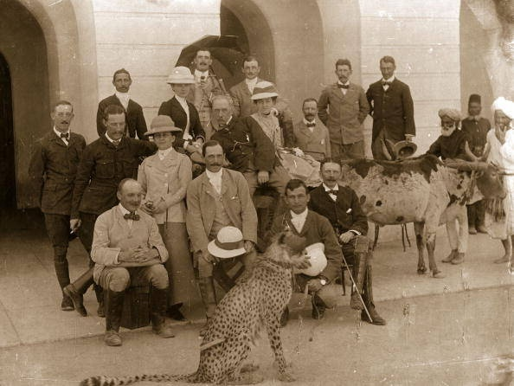
© Brain Wrinkles

Slide 8
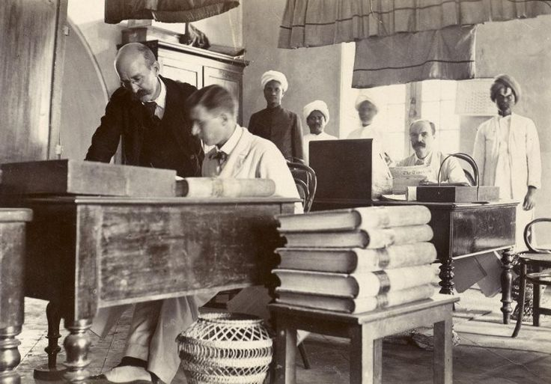
© Brain Wrinkles

Slide 9
Colonial Life
Great Britain took complete authority over the colony and denied Indians any role in the government of their nation.
Indians were treated as second-class citizens in their own country.
There was inequality under British laws.
© Brain Wrinkles

Slide 10
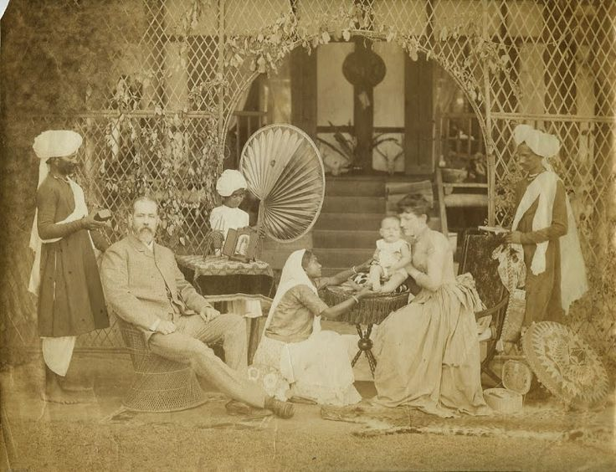
© Brain Wrinkles

Slide 11
Colonial Life
Indians also faced discrimination and unjust treatment in British society.
The best jobs and schools were only available to the British.
  Indians were also taxed heavily by the British on goods that were found in their own country.
© Brain Wrinkles

Slide 12
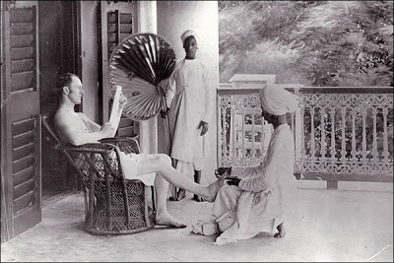
© Brain Wrinkles

Slide 13
Resentment
Indians began to resent being ruled by a foreign government and began to protest for changes.
Great Britain eventually offered some reforms, but they were small and not enough.
Indians were frustrated with the lack of change, and began to call for Indian independence.
© Brain Wrinkles

Slide 14
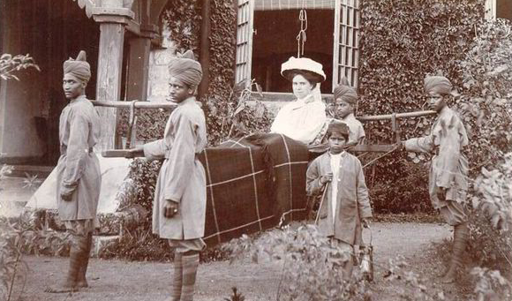
© Brain Wrinkles

Slide 15
Nationalism
In the 1800s, a feeling of nationalism grew in India.
Nationalism is a belief that people should be loyal to those with whom they share common history and customs.
The first two groups to work for the rights of Indians were the Indian National Congress in 1885 and the Muslim League in 1906.
© Brain Wrinkles

Slide 16
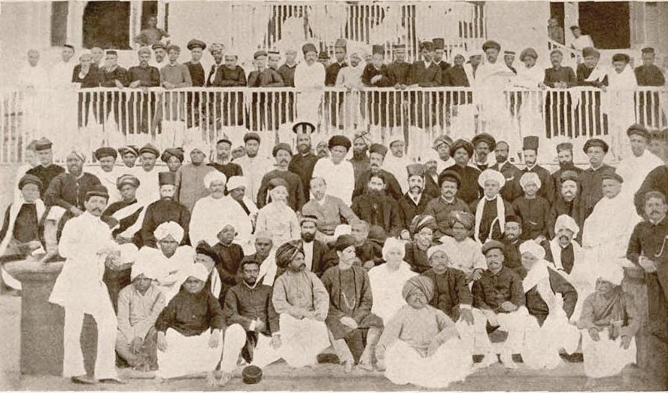
The First Indian National Congress, 1885
© Brain Wrinkles

Slide 17
WWI’s Impact
During World War I, millions of Indians joined with the British army.
The British Parliament promised them that when the war ended, Indians would be able to have more control of their government.
© Brain Wrinkles

Slide 18
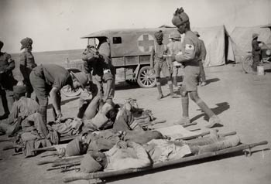
Indian Medic Troops During WWI
© Brain Wrinkles

Slide 19
Protests
Unfortunately, nothing really changed after the war and some Indian leaders argued for taking over the British government by force.
Many Indians were upset with the British false promises.
Those who protested were arrested and sent to jail for up to two years without a trial.
© Brain Wrinkles

Slide 20
Amritsar
In 1919, outside of the Temple of Amritsar, British soldiers started shooting a large group of Indians who they claimed were “gathering illegally”.
  During this terrible tragedy, over 400 people were killed and 1200 were injured.
  It was this awful massacre that spurred Mohandas Gandhi into action to fight for India’s independence.
© Brain Wrinkles

Slide 21
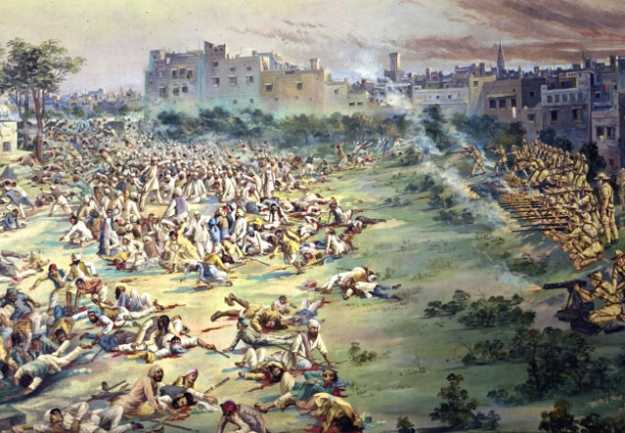
© Brain Wrinkles

Slide 22
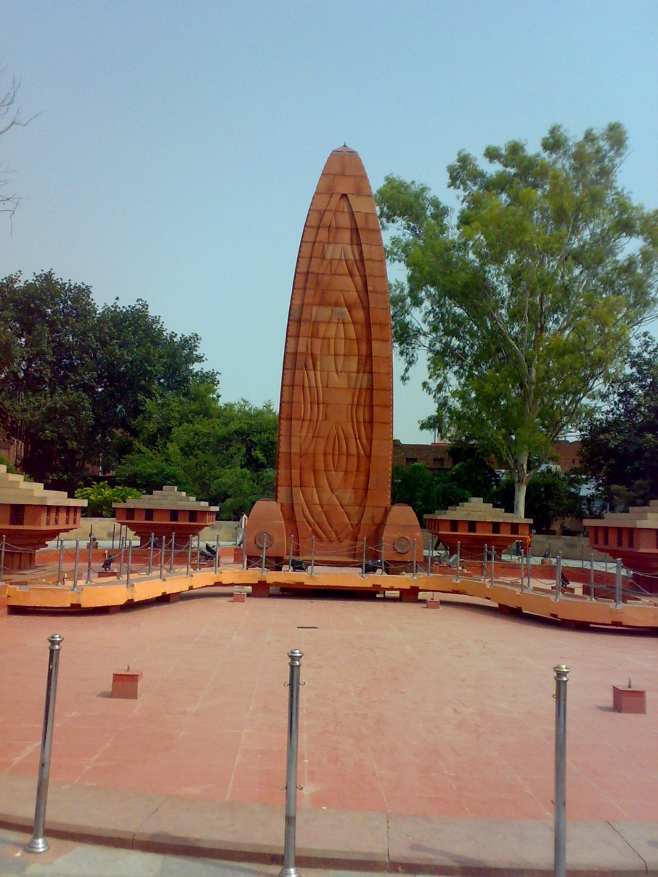
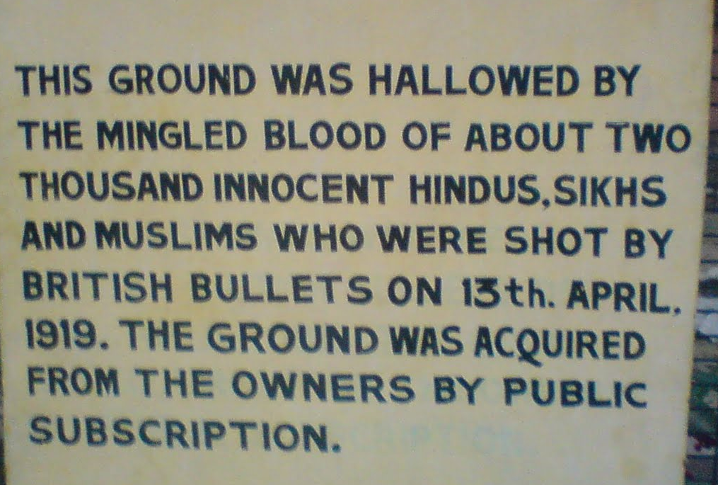
Jallianwala Memorial – Amritsar
© Brain Wrinkles

Slide 23
Gandhi
Mohandas Karamchand Gandhi was born in India on October 2nd, 1869 and studied law in England.
After practicing law in South Africa during Apartheid, he returned to India in 1914 with a determination that people should be treated equally, no matter their race or religion.
He was shocked by the way Indians were segregated and oppressed by British authorities.
© Brain Wrinkles

Slide 24
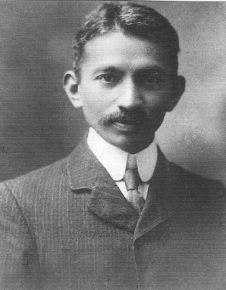
Lawyer
Mohandas Gandhi
1909
© Brain Wrinkles

Slide 25
Gandhi
After the Amritsar massacre, Gandhi quit practicing law and decided to devote his life to fighting for the equality of all Indians.
He was enraged at how the British discriminated against Indians.
Gandhi believed it was time for the people of India to stop obeying the unjust British laws.
© Brain Wrinkles

Slide 26
Nonviolence
Gandhi did not think that forceful resistance was the right path for Indian independence.
Instead, he encouraged his followers to practice nonviolent protests against the British in order to bring about social change.
Gandhi encouraged Indian followers to disobey unjust British laws in a peaceful manner, without using violence.
© Brain Wrinkles

Slide 27
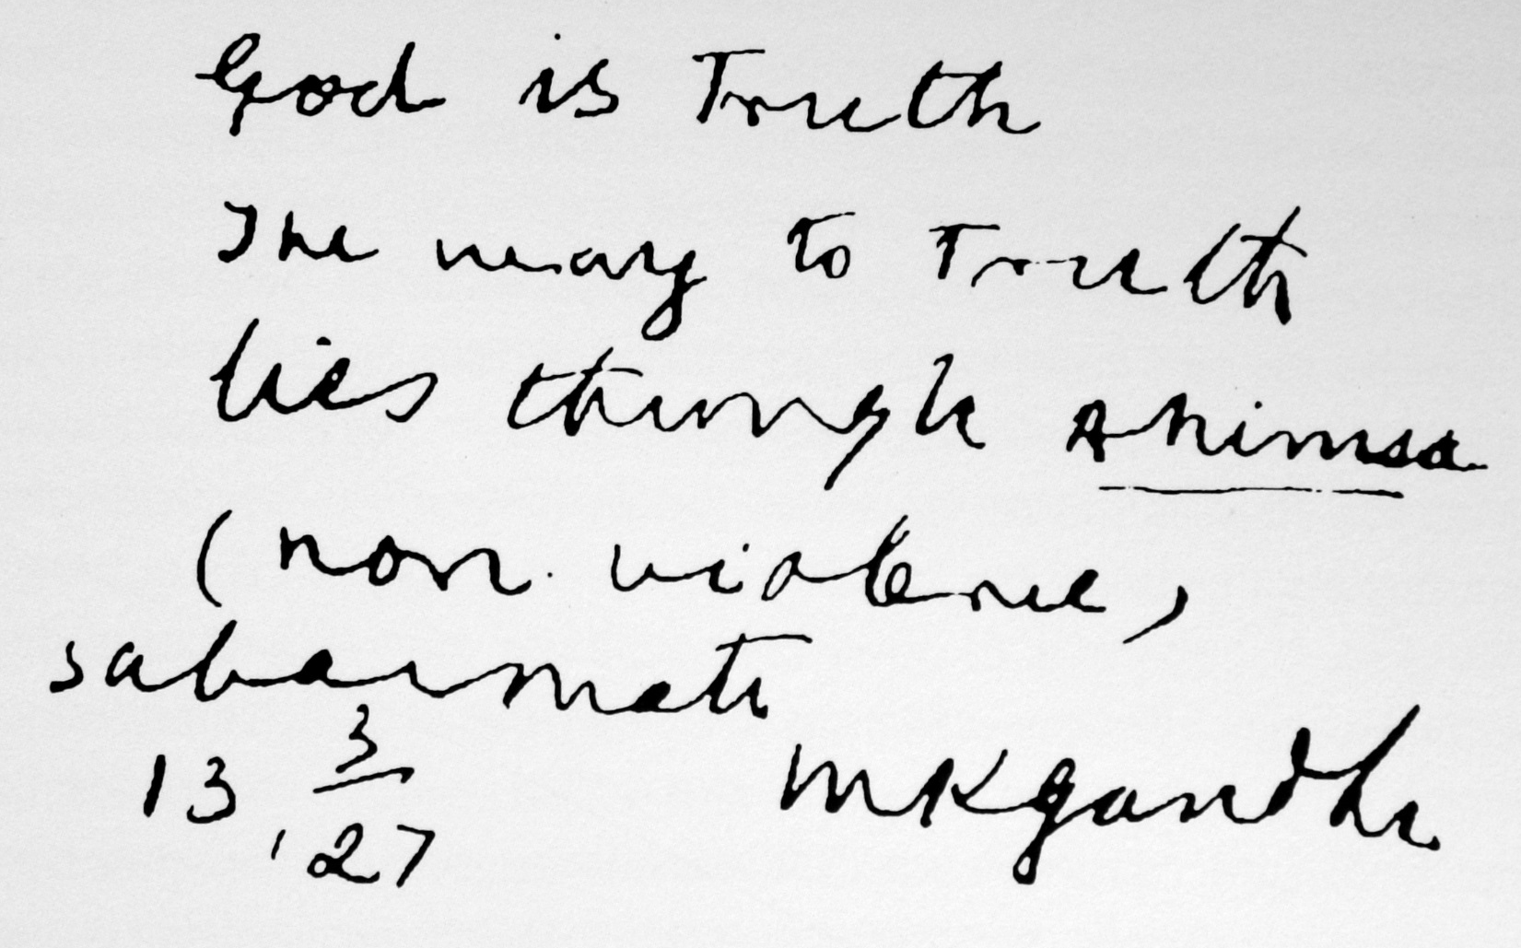
God is truth the way to truth lies through Ahimsa (non-violence).
Sabarmati, March 13, 1927
M K Gandhi
© Brain Wrinkles

Slide 28
Social Change
Gandhi developed what he called a “system of civil disobedience” and believed that it would make the world recognize the injustice in India and force change without using violence.
He believed that acts of goodness produced positive reactions while violence only produced negative ones.
Gandhi led his followers in economic boycotts, hunger strikes, and nonviolent protests to oppose the unfair treatment of Indians.
© Brain Wrinkles

Slide 29
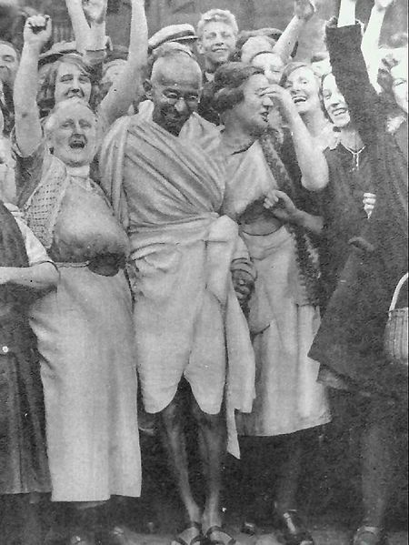
Gandhi on strike with textile workers in 1931.
© Brain Wrinkles

Slide 30
Salt March
In 1930, Gandhi led a 240-mile march to the ocean to oppose a British tax on salt.
Guards responded by clubbing and beating the peaceful protestors.
News of this event spread worldwide and people around the world began to call for the British to grant Indian independence.
© Brain Wrinkles

Slide 31
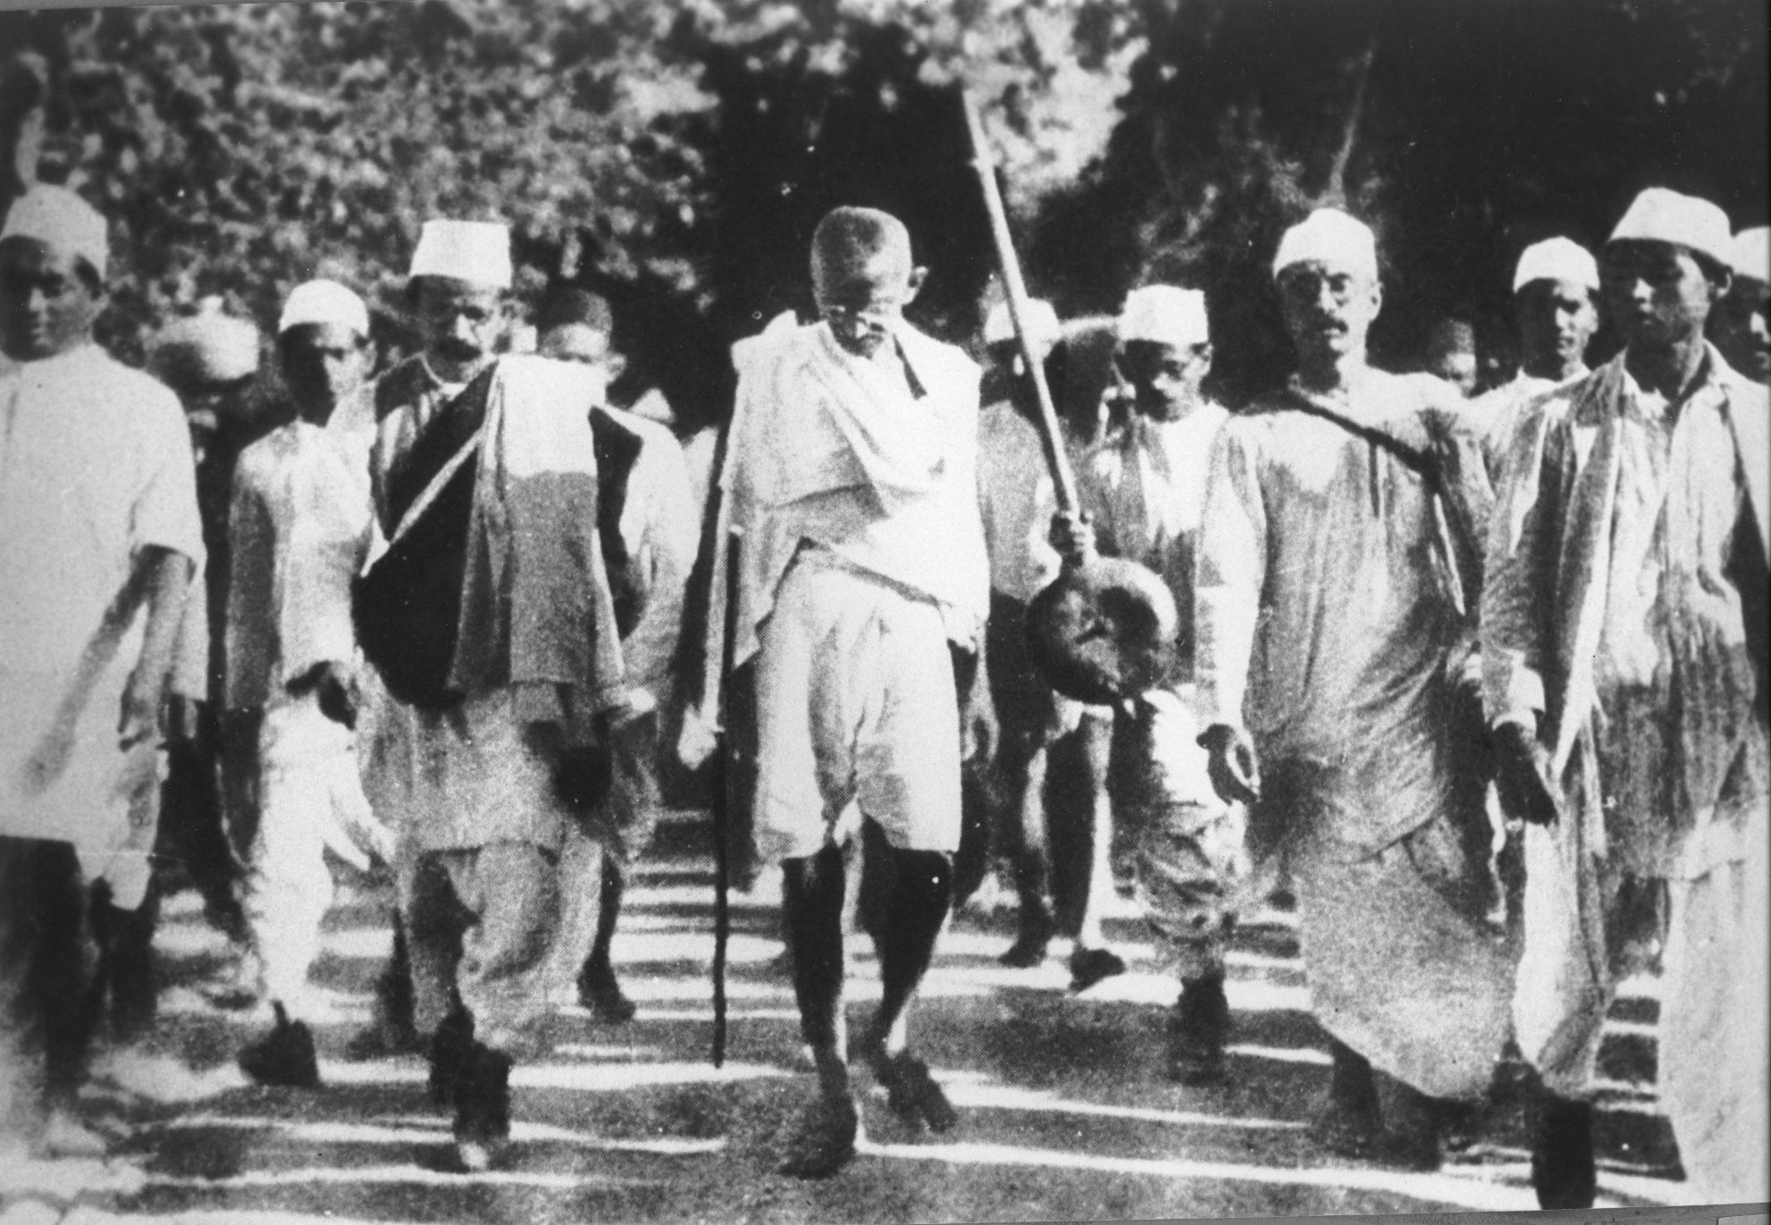
Gandhi during the Salt March, 1930.
© Brain Wrinkles

Slide 32
Support
Even though Gandhi and his followers practiced non-violence, the British authorities did not.
The Indian protestors suffered brutal beatings and long prison sentences.
Despite the dangers, more and more Indians followed Gandhi’s wisdom of non-violent resistance and generated support for nationalism and independence.
© Brain Wrinkles

Slide 33
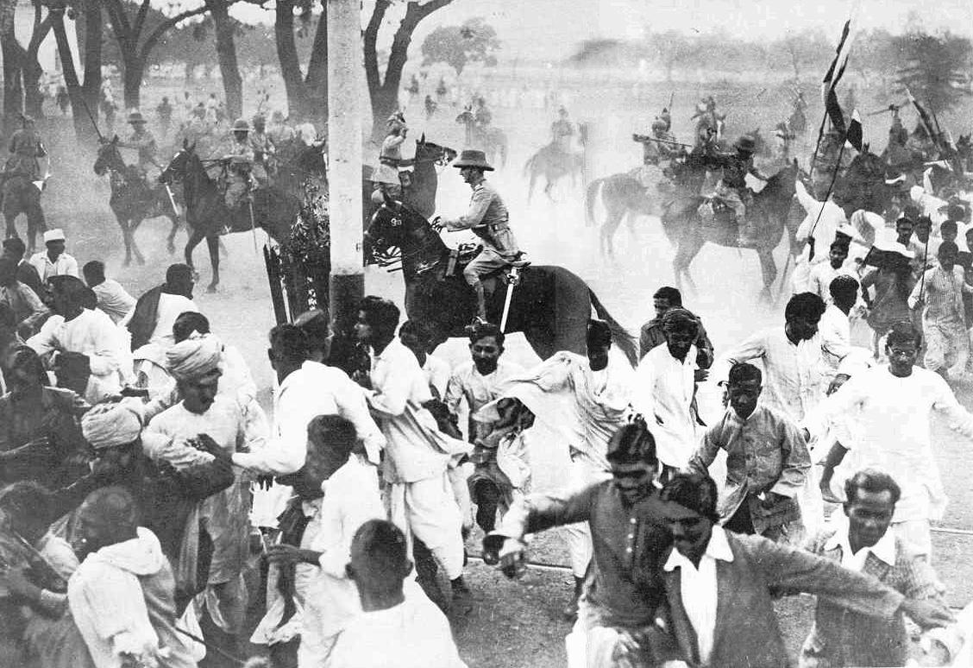
© Brain Wrinkles

Slide 34
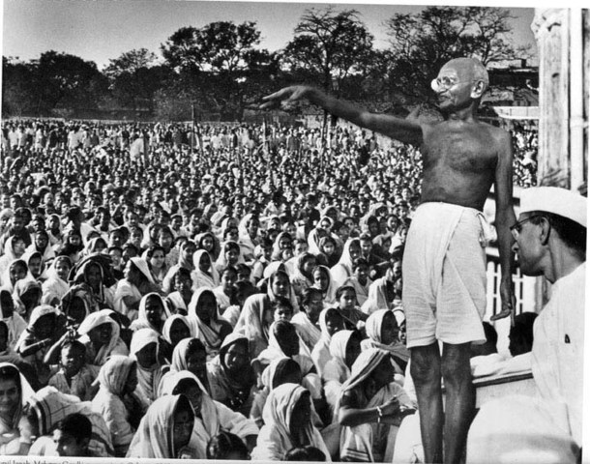
© Brain Wrinkles

Slide 35
Independence
After fighting in WWII, Britain no longer had enough money or people to keep India under its control.
Great Britain finally agreed to give up their colonial claims to India.
On August 15, 1947, the Republic of India was established.
Today, many Indians credit India’s independence to the efforts of Gandhi.
© Brain Wrinkles

Slide 36
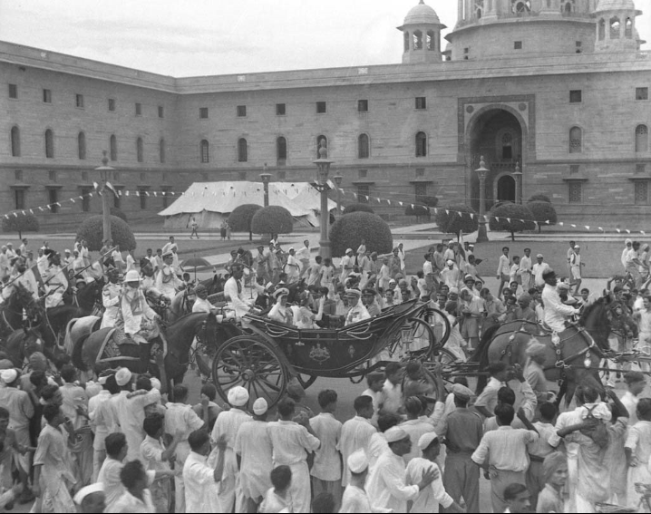
India’s Independence Day
© Brain Wrinkles

Slide 37
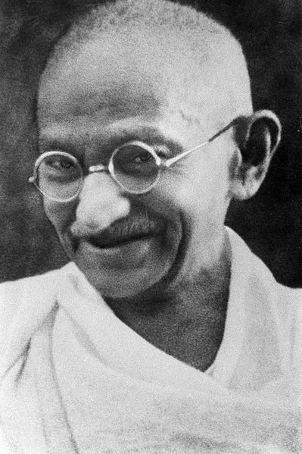
Many Indians lovingly call Mohandas Gandhi Mahatma, or “great soul”
Late 1930s
© Brain Wrinkles

Slide 38
Split India
Even though India had won its independence, things were not peaceful in the country.
Hindus and Muslims could not reach a solution as to how to rule an independent India.
Eventually, the country was split into India for the Hindus and Pakistan for the Muslims.
© Brain Wrinkles

Slide 39
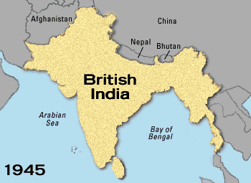
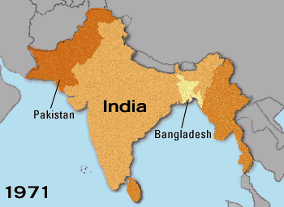
© Brain Wrinkles

Slide 40
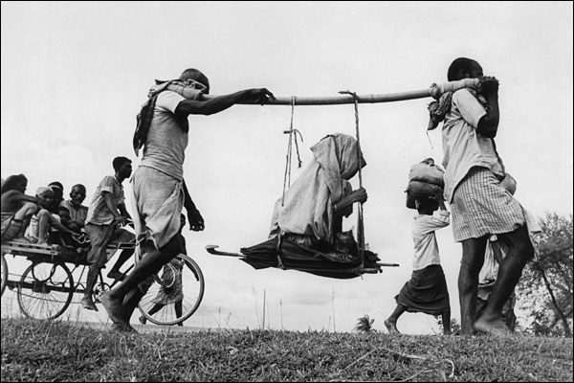
Two Muslim men carrying an elderly woman to their new home in Pakistan.
© Brain Wrinkles

Slide 41
Turmoil
The partition of India led to genocide; hundreds of thousands of people were killed in widespread violence.
Gandhi was very much disappointed by the partition because he wanted all Indians to live together peacefully in one country.
Even though he was Hindu, he felt that all religious groups should be welcomed in India.
© Brain Wrinkles

Slide 42
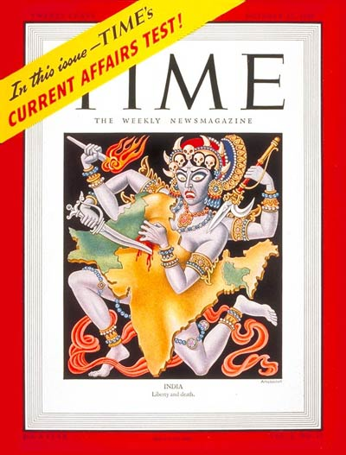
Time Magazine cover representing the partition of India - 1947.
© Brain Wrinkles

Slide 43
Gandhi
In 1948, at the age of 78, Mohandas Gandhi was assassinated on his way to a prayer meeting in New Delhi.
He was shot three times by a high-ranking Brahmin who resented Gandhi’s concern for Muslims.
© Brain Wrinkles

Slide 44
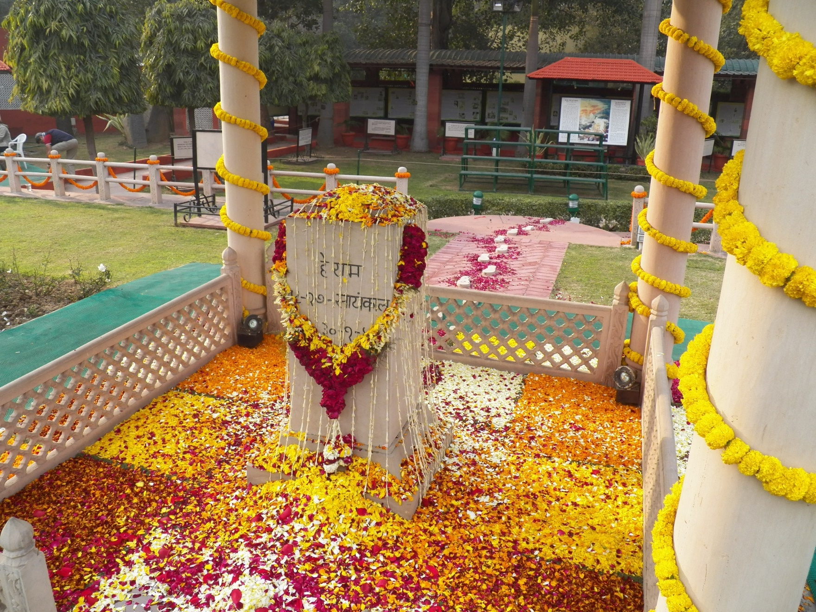
Memorial where Mohandas Gandhi was assassinated.
© Brain Wrinkles

Slide 45
India’s Independence– A History Storyboard
Directions: Create a storyboard that outlines the history of India’s Independence. Write a caption and draw an illustration to portray each event.
East India Trading Company arrived in India and set up trading posts Illustration will vary. | India officially declared a colony of the British empire; Indians treated as second-class citizens in their own country Illustration will vary. | Massacre of Amritsar-British soldiers killed over 400 people and injured 1200 because they were “illegally gathering”; event spurred Gandhi to fight for independence Illustration will vary.
Gandhi led 240-mile march to the ocean to protest British tax on salt; gained worldwide recognition; world put pressure on GB to grant independence Illustration will vary. | Republic of India was established & then split into two parts. Hindu-India and Muslim-Pakistan Illustration will vary. | Gandhi was assassinated. The murderer resented Gandhi for wanting Hindu & Muslims to live together peacefully. Illustration will vary.
1601
1765
1919
1930
1947
1948
© Brain Wrinkles

Slide 46

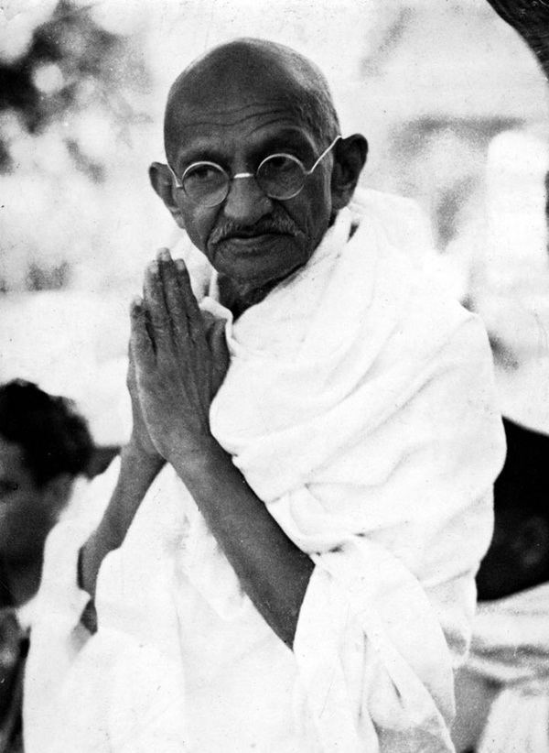
“You must be the change you want to see in the world.”
#MohandasGandhi

Slide 47
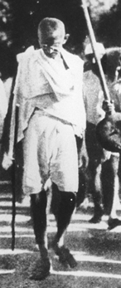
“You must not lose faith in humanity. Humanity is an ocean; if a few drops of the ocean are dirty, the ocean does not become dirty.”
#MohandasGandhi

Slide 48
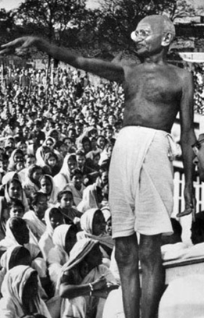
“Honest disagreement is often a good sign of progress.”
#MohandasGandhi

Slide 49
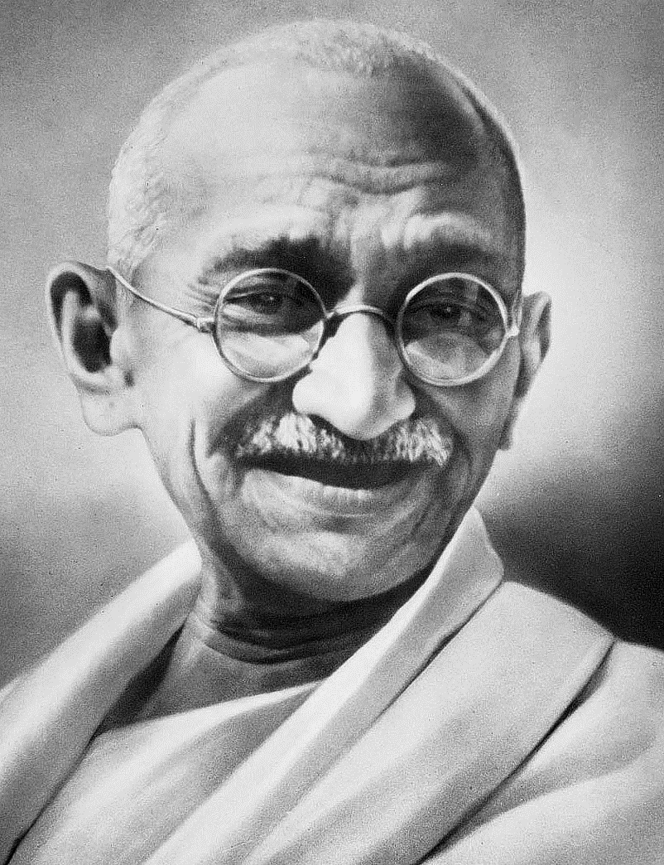
“An eye for an eye makes the whole world blind.”
#MohandasGandhi

Slide 50
TEACHER INFO: Comprehension Check
Print off the Comprehension Check for each student. (Print front-to-back to save paper.)
The students will complete this handout at the end of the lesson. You can count this as a quiz!
© Brain Wrinkles

Slide 51
1. How did Great Britain begin its relationship with India?
2. What happened to India’s government when the country became a colony of Great Britain?
3. What was life like for Indians when the country was part of the British empire?
4. What was Mohandas Gandhi’s early life like before he became involved in civil disobedience?
5. Describe Gandhi’s role in India’s Independence Movement:
6. How did British authorities react to Gandhi and his followers when they help boycotts, protests, and marches?
7. What things caused British control in India to weaken?
8. When was the Republic of India formed?
9. What caused India to split after Great Britain left?
10. What happened to Mohandas Gandhi in 1948?
© Brain Wrinkles
India’s Independence
Comprehension Check

Slide 52
1. How did Great Britain begin its relationship with India?
They were trading partners
2. What happened to India’s government when the country became a colony of Great Britain?
Great Britain gained control of the government; Indians had no say in government
3. What was life like for Indians when the country was part of the British empire?
Terrible, treated like 2nd class citizens; unequal rights, poor jobs and education
4. What was Mohandas Gandhi’s early life like before he became involved in civil disobedience?
Educated man—studied law in England and practiced law in South Africa during Apartheid.
5. Describe Gandhi’s role in India’s Independence Movement:
Gandhi encouraged his followers to practice non-violent protests; many Indians followed him and eventually forced Great Britain to recognize their desire for independence
6. How did British authorities react to Gandhi and his followers when they help boycotts, protests, and marches?
Met them with violence (brutal beatings) and prison sentences
7. What things caused British control in India to weaken?
Worldwide recognition, more and more Indian protestors, Britain’s involvement in WWII—lacked money and resources to maintain colony
8. When was the Republic of India formed?
1947
9. What caused India to split after Great Britain left?
Muslims and Hindus could not agree on how to govern the country
10. What happened to Mohandas Gandhi in 1948?
He was assassinated because he thought all Indians should live together peacefully regardless of religious beliefs
© Brain Wrinkles
India’s Independence
Comprehension Check

Slide 53
Social Change
Gandhi developed what he called a “system of civil disobedience” and believed that it would make the world recognize the injustice in India and force change without using violence.
He believed that acts of goodness produced positive reactions while violence only produced negative ones.
Gandhi led his followers in economic boycotts, hunger strikes, and nonviolent protests to oppose the unfair treatment of Indians.
Salt March
In 1930, Gandhi led a 240-mile march to the ocean to oppose a British tax on salt.
Guards responded by clubbing and beating the peaceful protestors.
News of this event spread worldwide and people around the world began to call for the British to grant Indian independence.
Support
Even though Gandhi and his followers practiced non-violence, the British authorities did not.
The Indian protestors suffered brutal beatings and long prison sentences.
Despite the dangers, more and more Indians followed Gandhi’s wisdom of non-violent resistance and generated support for nationalism and independence.
Independence
After fighting in WWII, Britain no longer had enough money or people to keep India under its control.
Great Britain finally agreed to give up their colonial claims to India.
On August 15, 1947, the Republic of India was established.
Today, many Indians credit India’s independence to the efforts of Gandhi.
Split India
Even though India had won its independence, things were not peaceful in the country.
Hindus and Muslims could not reach a solution as to how to rule an independent India.
Eventually, the country was split into India for the Hindus and Pakistan for the Muslims.
© Brain Wrinkles
India’s Independence
CLOZE Notes 3

Slide 54
Trading
In 1601, the British business, East India Trading Company, arrived in India and began setting up trading posts.
Great Britain began trading with India in the 1660s.
  At first, the British were only interested in trading goods (ivory, gold, silks, dyes) and spices (cinnamon, saffron, pepper, sugar, vanilla).
  A Colony
By 1760, Great Britain had gained economic and political control over India.
Great Britain official took control of the entire country when it declared India a colony of the British empire in 1765.
Colonial Life
Great Britain took complete authority over the colony and denied Indians any role in the government of their nation.
Indians were treated as second-class citizens in their own country.
There was inequality under British laws.
Indians also faced discrimination and unjust treatment in British society.
The best jobs and schools were only available to the British.
  Indians were also taxed heavily by the British on goods that were found in their own country.
  Resentment
Indians began to resent being ruled by a foreign government and began to protest for changes.
Great Britain eventually offered some reforms, but they were small and not enough.
Indians were frustrated with the lack of change, and began to call for Indian independence.
Nationalism
In the 1800s, a feeling of nationalism grew in India.
Nationalism is a belief that people should be loyal to those with whom they share common history and customs.
The first two groups to work for the rights of Indians were the Indian National Congress in 1885 and the Muslim League in 1906.
© Brain Wrinkles
India’s Independence
CLOZE Notes 1

Slide 55
Turmoil
The partition of India led to genocide; hundreds of thousands of people were killed in widespread violence.
Gandhi was very much disappointed by the partition because he wanted all Indians to live together peacefully in one country.
Even though he was Hindu, he felt that all religious groups should be welcomed in India.
Gandhi
In 1948, at the age of 78, Mohandas Gandhi was assassinated on his way to a prayer meeting in New Delhi.
He was shot three times by a high-ranking Brahmin who resented Gandhi’s concern for Muslims.
© Brain Wrinkles
India’s Independence
CLOZE Notes 4

Slide 56
WWI’s Impact
During World War I, millions of Indians joined with the British army.
The British Parliament promised them that when the war ended, Indians would be able to have more control of their government.
Protests
Unfortunately, nothing really changed after the war and some Indian leaders argued for taking over the British government by force.
Many Indians were upset with the British false promises.
Those who protested were arrested and sent to jail for up to two years without a trial.
Amritsar
In 1919, outside of the Temple of Amritsar, British soldiers starting shooting a large group of Indians who they claimed were “gathering illegally”.
  During this terrible tragedy, over 400 people were killed and 1200 were injured.
  It was this awful massacre that spurred Mohandas Gandhi into action to fight for India’s independence.
  Gandhi
Mohandas Karamchand Gandhi was born in India on October 2nd, 1869 and studied law in England.
After practicing law in South Africa during Apartheid, he returned to India in 1914 with a determination that people should be treated equally, no matter their race or religion.
He was shocked by the way Indians were segregated and oppressed by British authorities.
After the Amritsar massacre, Gandhi quit practicing law and decided to devote his life to fighting for the equality of all Indians.
He was enraged at how the British discriminated against Indians.
Gandhi believed it was time for the people of India to stop obeying the unjust British laws.
Nonviolence
Gandhi did not think that forceful resistance was the right path for Indian independence.
Instead, he encouraged his followers to practice nonviolent protests against the British in order to bring about social change.
Gandhi encouraged Indian followers to disobey unjust British laws in a peaceful manner, without using violence.
© Brain Wrinkles
India’s Independence
CLOZE Notes 2

Slide 57
Name:
Name:
Make A
Connection
Make A
Connection
Think of someone that Gandhi reminds you of. In the boxes below, compare and contrast this person’s life and actions with Gandhi’s.
Think of someone that Gandhi reminds you of. In the boxes below, compare and contrast this person’s life and actions with Gandhi’s.
Mohandas Gandhi
Mohandas Gandhi
____________________
____________________
© Brain Wrinkles
© Brain Wrinkles

Slide 58



© Brain Wrinkles. Your download includes a limited use license from Brain Wrinkles. The purchaser may use the resource for personal classroom use only. The license is not transferable to another person. Other teachers should purchase their own license through my store.
This resource is not to be used:
By an entire grade level, school, or district without purchasing the proper number of licenses. For school/district licenses at a discount, please contact me.
As part of a product listed for sale or for free by another individual.
On shared databases.
Online in any way other than on password-protected website for student use only.
© Copyright Brain Wrinkles. All rights reserved. Permission is granted to copy pages specifically designed for student or teacher use by the original purchaser or licensee. The reproduction of any other part of this product is strictly prohibited. Copying any part of this product and placing it on the Internet in any form (even a personal/classroom website) is strictly forbidden. Doing so makes it possible for an Internet search to make the document available on the Internet, free of charge, and is a violation of the Digital Millennium Copyright Act (DMCA).
Thank you,
Ansley at Brain Wrinkles
Terms of Use
Clipart, fonts, & digital papers for this product were purchased from:

